Slide 1


目录
CONTENTS
01
02
03
Face Database Platform
AI Capability Center
Discussion on Cooperation Models

Slide 2
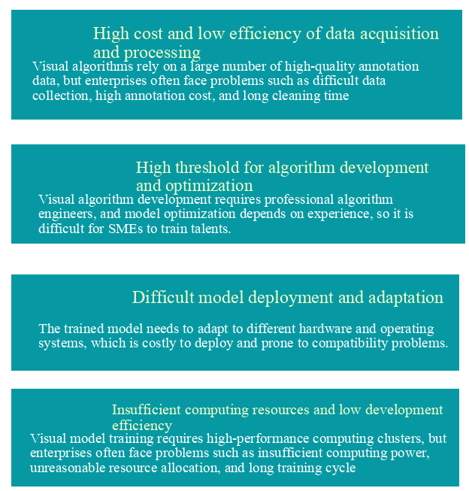


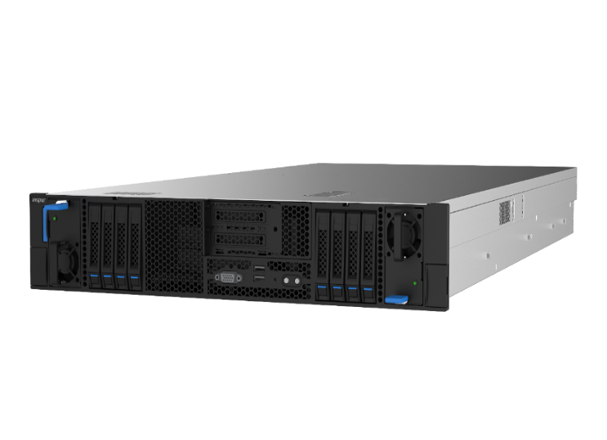

02 AI Capability Center– AI algorithm training and development pain points
pycharm jupyter VSCode sublime

Slide 3
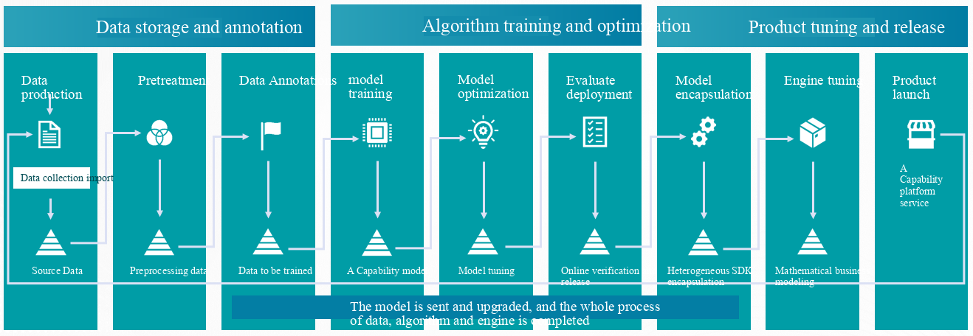
02 AI Capability Center– AI productivity platform
  With the goal of efficient AI production and standardized application integration, we will achieve end-to-end one-stop implementation of algorithm engineering to industry applications, comprehensively improve AI development efficiency, and reduce R&D management costs.
Comprehensively improve AI R&D landing efficiency by 40%, and reduce R&D management costs by more than 30%.

Slide 4
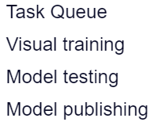
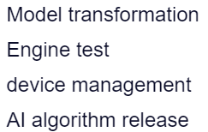

02 AI Capability Center– AI productivity platform
data
management
Model development
Engine adaptation
Raw data management
Data preprocessing
Data Annotations
一体化开发平台
Multimodal data management
Multi frame algorithm
Support multiple inference devices
NVIDIA Tesla T4板卡
MXNet
寒武纪思元270-S4板卡
PyTorch
算能SC5分析板卡
华为昇腾710分析板卡
Raw data, safe storage of data, fast call and docking.
Create a multi framework online training visualization platform to accelerate model iteration, optimization, development and training
A variety of device engines are encapsulated, managed and used to produce AI algorithms in different ecosystems.

Slide 5
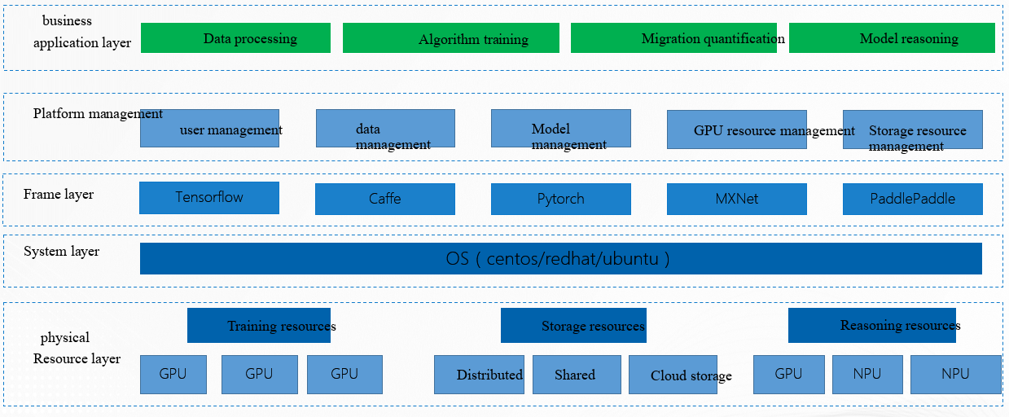
02 AI Capability Center– Functional architecture diagram

Slide 6
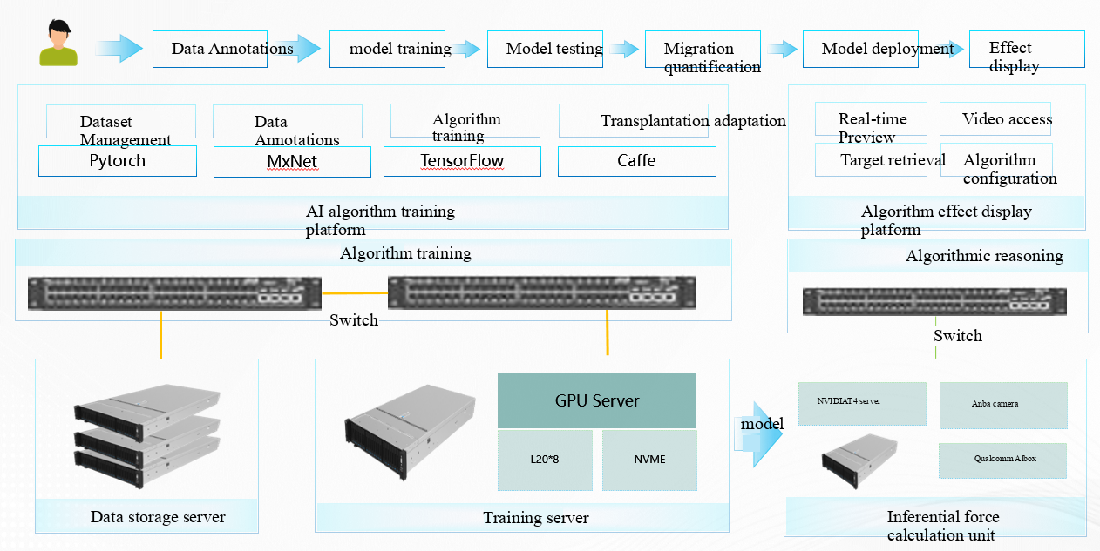
02 AI Capability Center– Functional architecture diagram

Slide 7
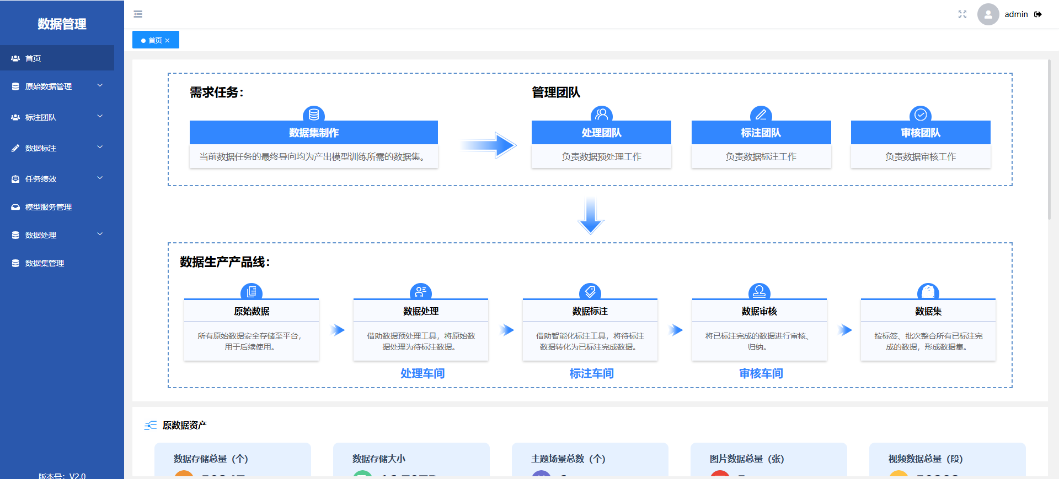
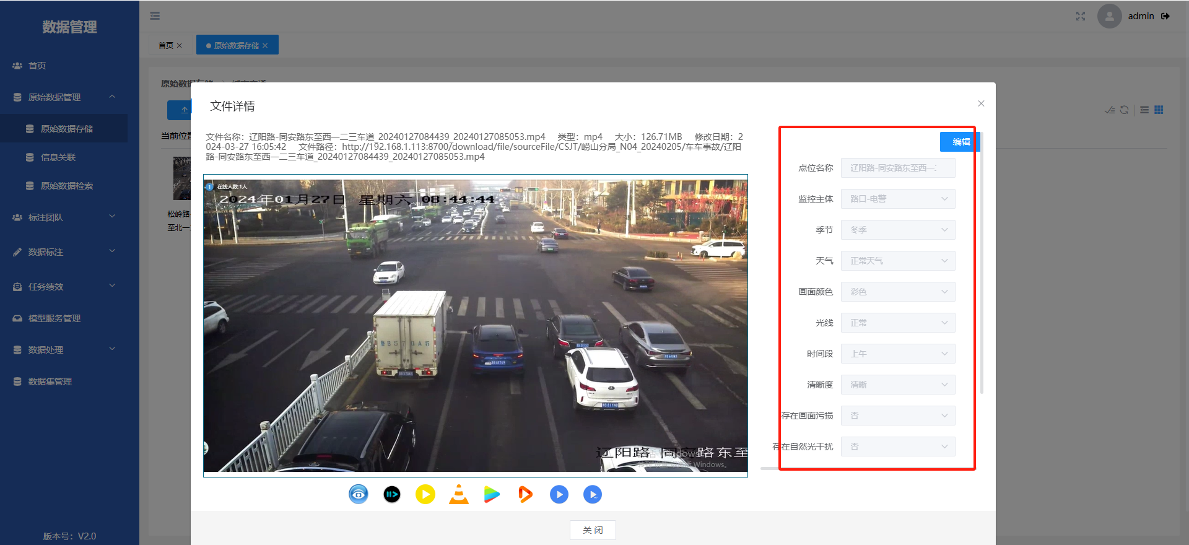
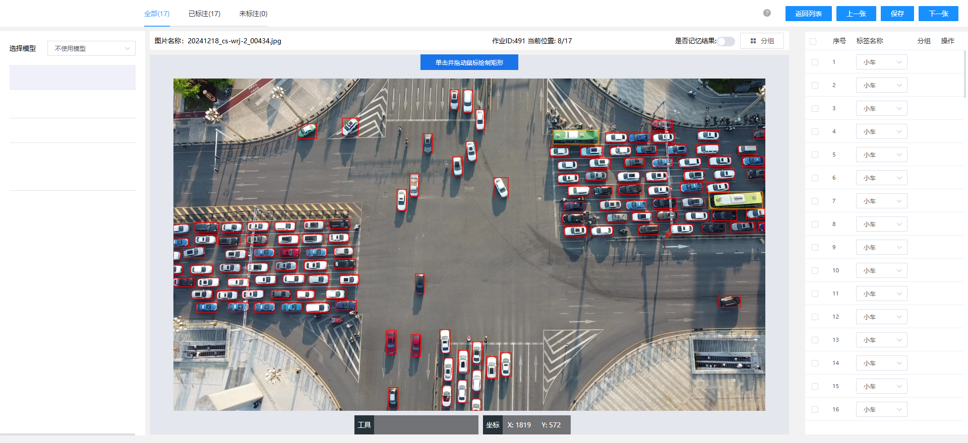
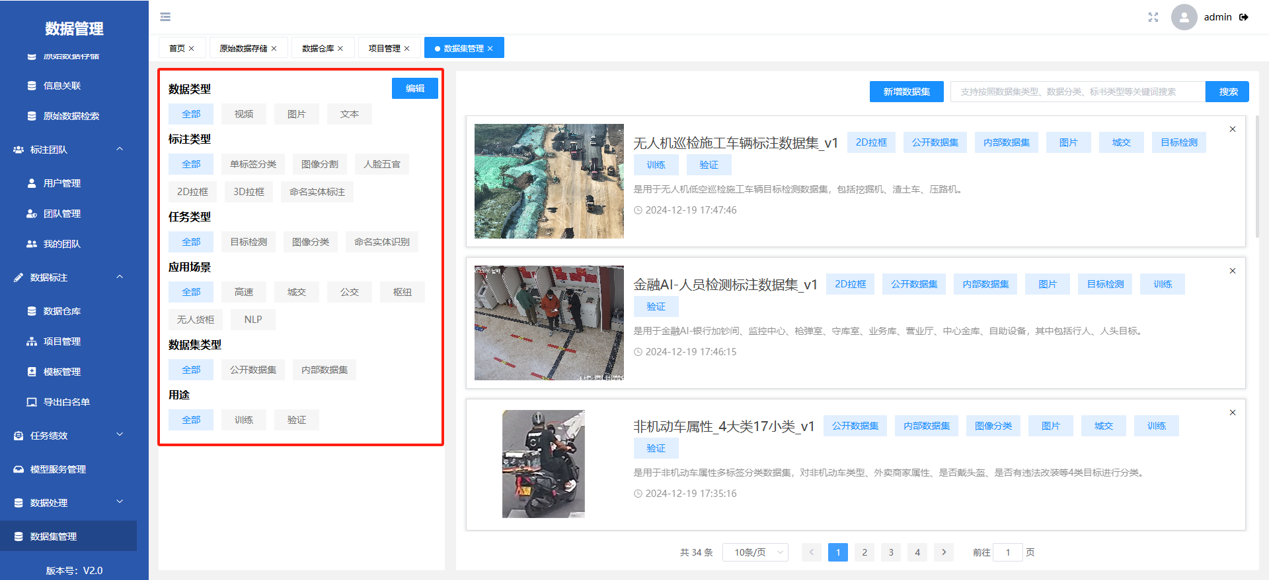
02 AI Capability Center – Data Management Module
  Efficient Data Pipeline – Secure asset management with high-quality, diverse training data.
Secure Data Asset Storage
PB-Scale Secure Data Storage with Multi-Label Classification & Second-Level Retrieval
Intelligent Data Annotation
Multi-Mode Annotation Suite – Supporting 3D/point cloud/AI-prelabeling (+6 methods) with 160%+ annotator efficiency gain.
8+ Scenario Massive Datasets
Multi-Scenario Datasets – 12.6TB curated data across transportation, maritime, healthcare, public security, and construction scenarios.
Tag-Based Data Asset Management & Feature Retrieval
Intelligent Pre-Labeling for Object Detection Models (Pedestrian/Vehicle/Non-Motorized, etc.)
Intelligent Dataset Classification for AI Model Training

Slide 8
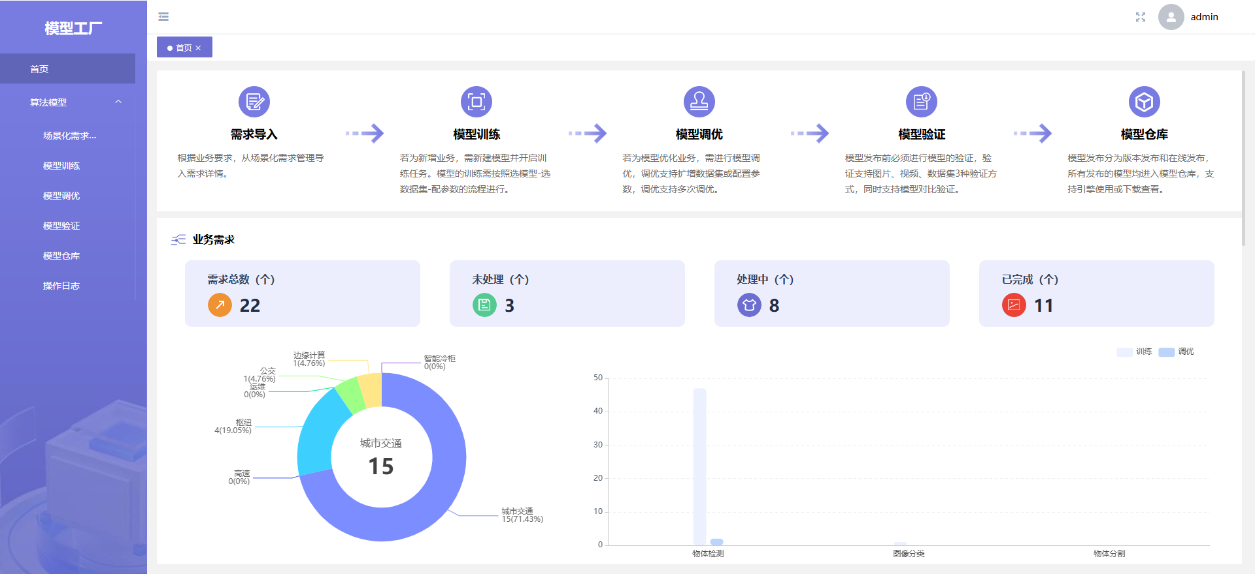
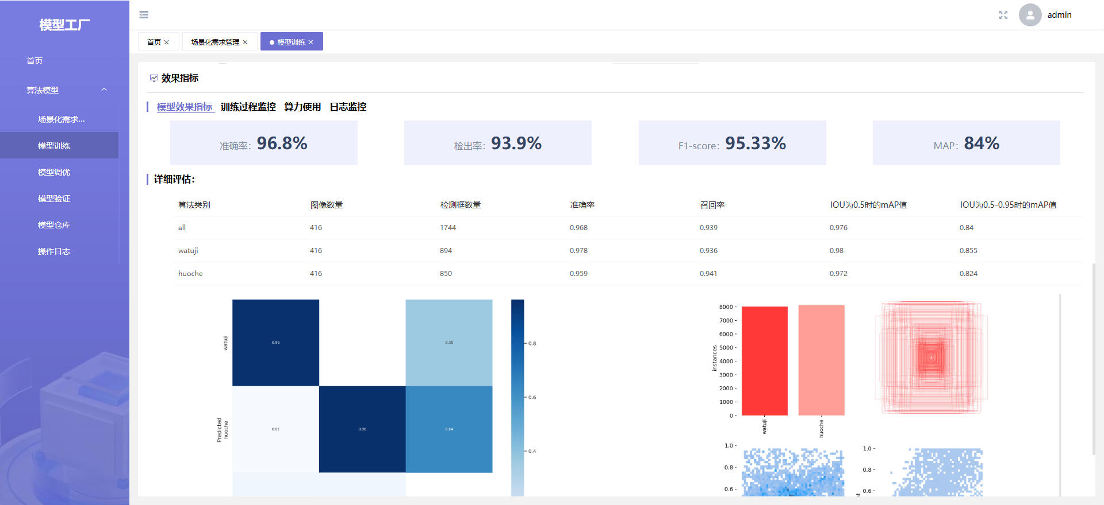
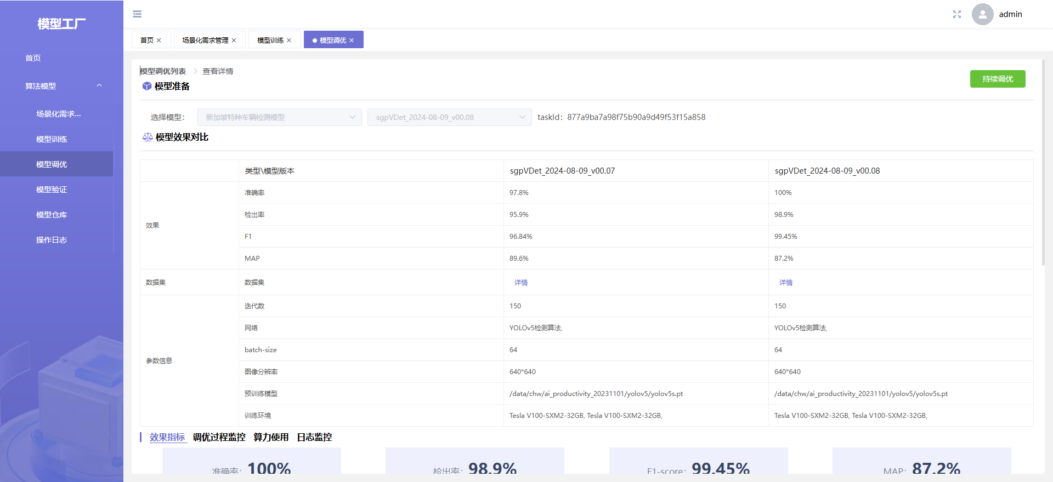
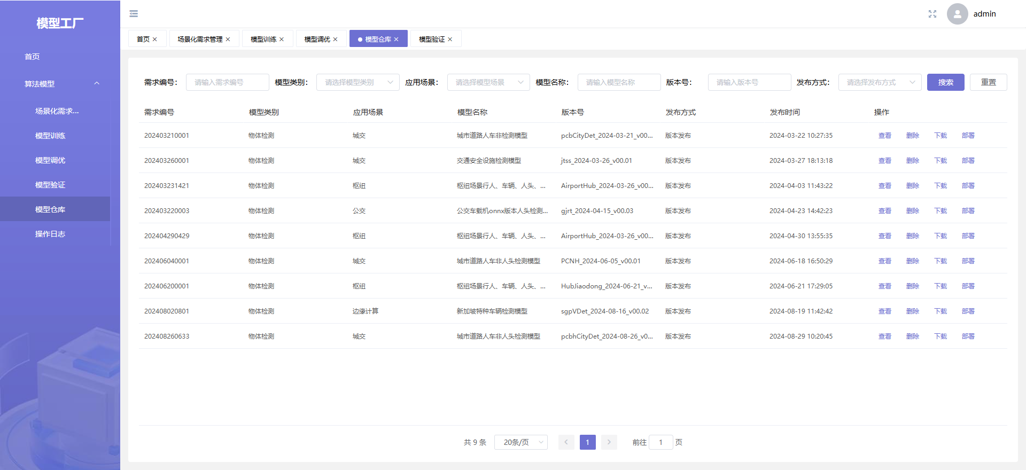
02 AI Capability Center – Model Factory Module
  Automated & Visualized Model Training, Tuning, and Evaluation System – Accelerates AI model iteration and optimization.
5+ Pre-Trained Model Frameworks
Multi-Framework Pre-Trained Model Support – Compatible with TensorFlow, PyTorch, PaddlePaddle, and other major frameworks.
Training Visualization
"Zero-Code" Visual Model Training – 50%+ efficiency boost with full-process monitoring for metrics, compute utilization, and logs.
Model Lifecycle Management (MLM)
End-to-End Model Lifecycle Management – Unified governance covering training, tuning, validation, and release.
Real-Time Model Training Metrics Dashboard – Monitor accuracy, detection rate, and mAP with live updates.
Multi-Model Tuning Comparison – Automated benchmarking to recommend optimal models.
Model Version Control & Provenance Tracking – Full lifecycle auditability for AI assets.

Slide 9
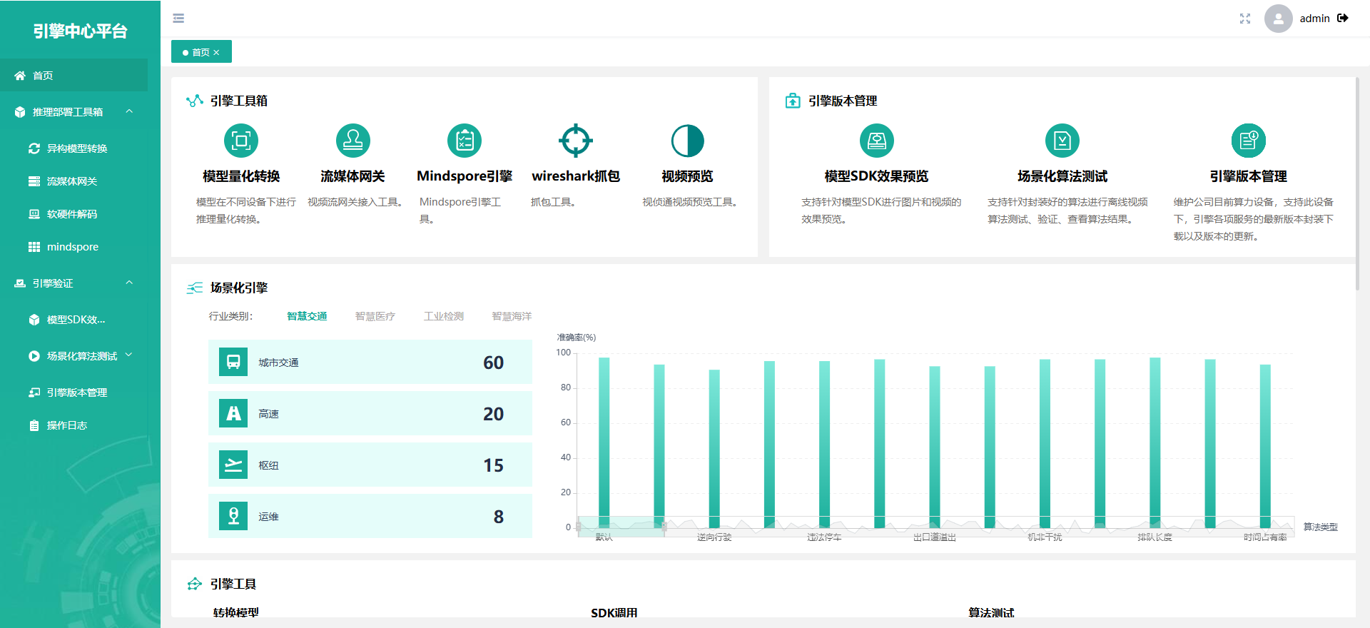
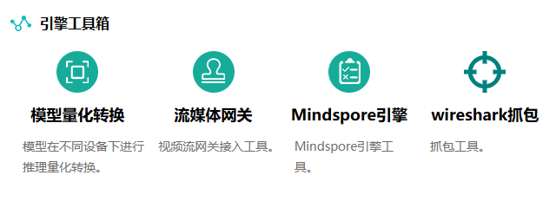
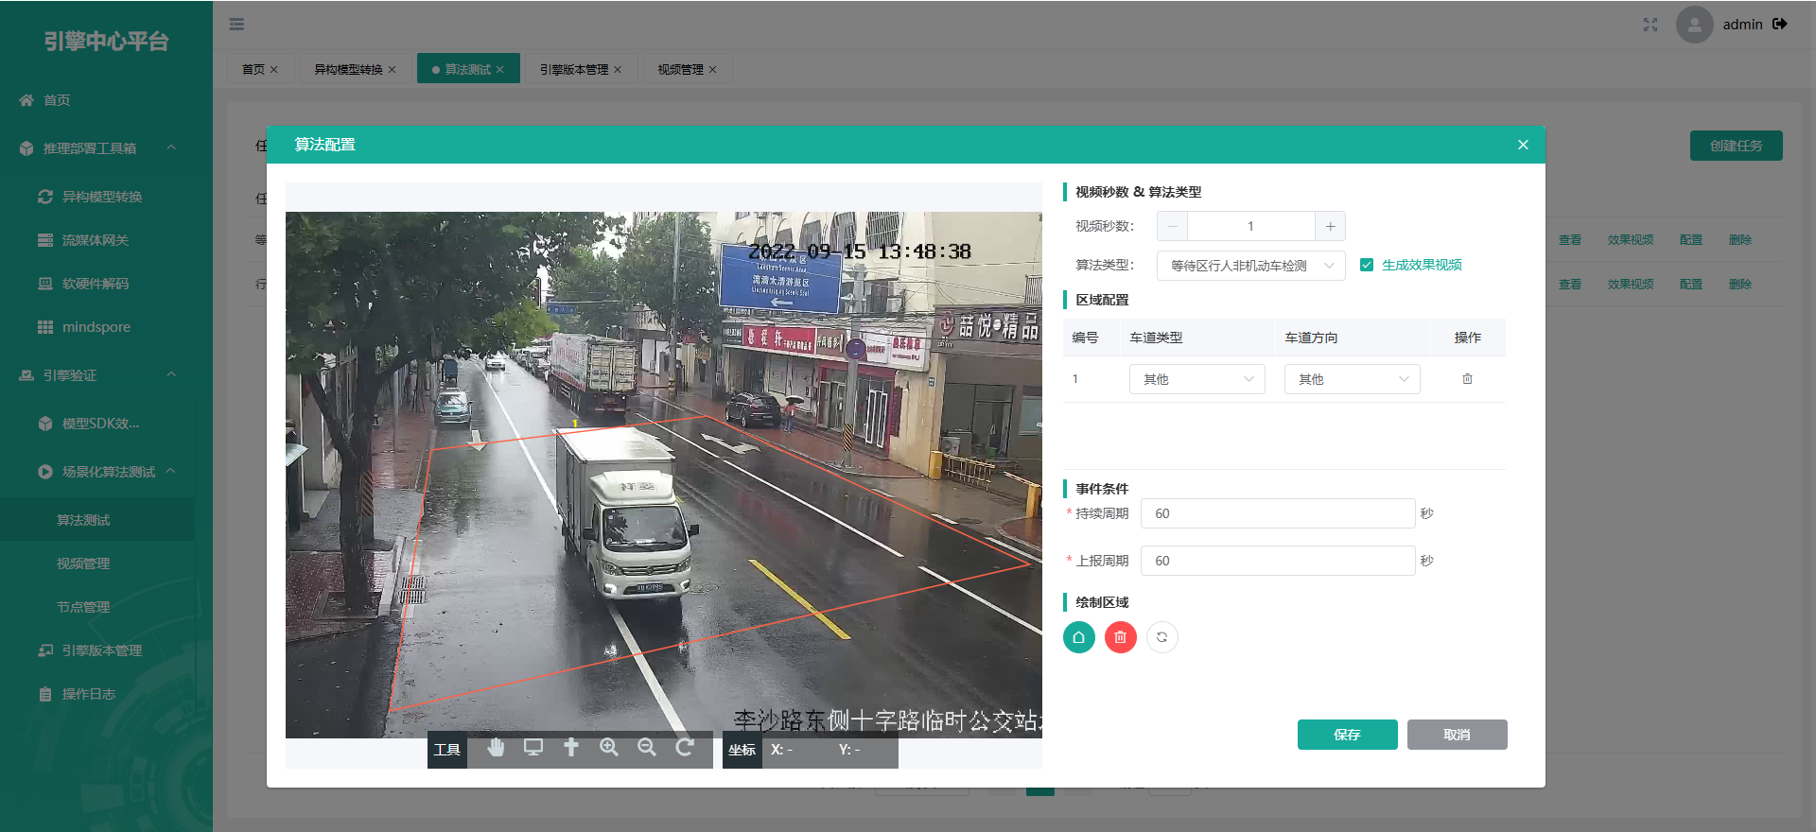
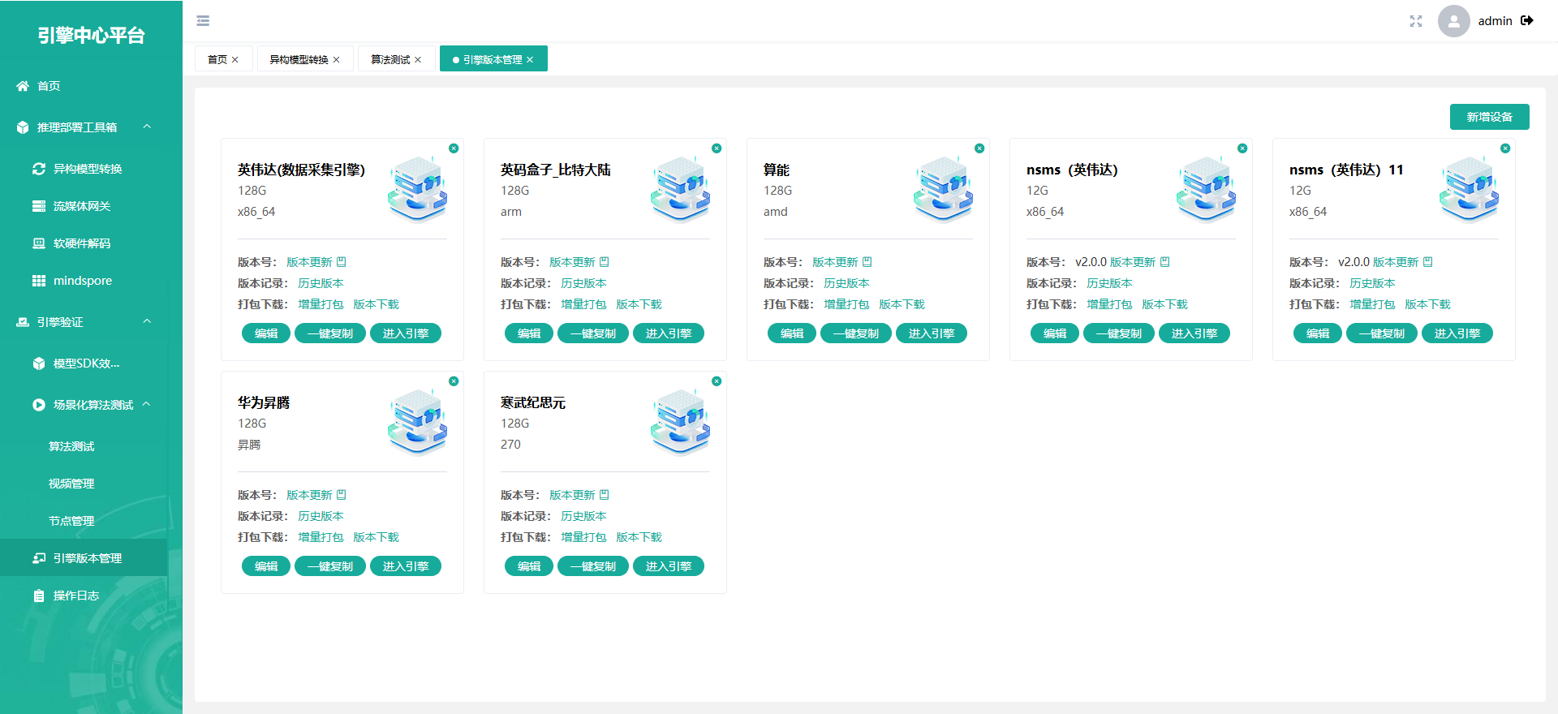
02 AI Capability Center – Engineering Engine Module
  Focus on engine tuning and deployment to enhance AI application efficiency, stability, and cost-effectiveness.
Multi-device Heterogeneous Adaptation
Comprehensive Hardware Support: NVIDIA T4/A10, Huawei Ascend,Cambricon MLUs,Intel Habana,AMD Instinct
Engine Packaging & Management
Model Packaging SDK - Enable one-click deployment and 80% faster operational efficiency.
AI Product Launch
Delivered 170+ AI algorithms deployed across 10+ cities including Qingdao, Zhenjiang, and Chengdu.
4+ Engine Tools – Ready for one-click download and immediate use.
Complete Offline Testing Protocol – Mandatory validation before product release.
Multi-Hardware Engine Adaptation – Supports one-click packaging and deployment.

Slide 10


